Slide 1
Frequency Distributions
Descriptive Statistics

Slide 2
Overview
Frequency distributions & tables
Relative & cumulative frequencies/percentages
Graphs

Slide 3
Describing data
On a 7pt scale with anchors of 1 (very easy) and 7 (very difficult), how difficult do you think this class is?
7 2 5 3 6 6
4 5 3 6 6 5
6 2 5 5 1 3
Notes:
You have collected data using reliable and valid measures. What do you do now with the data?
Data needs to be organized in some way to make it easier to understand
Imagine that you asked 18 people how difficult do you think this class is and these are their responses. How might you describe these data?
You might eyeball it and say will the fill range of values were used (i.e., at least one person said “1” and at least one said “7”). So there is some variability in participants responses. You might also point out that there are quite a few 5s and 6s, suggesting that several participants in the sample thought it was sort of difficult. Although this might be easy enough to eyeball with 18 participants, what if you had 1,000 – not so easy in that case.
A good place to start, in terms of organizing and understanding your data, is to make a frequency table and some kind of graph to summarize the data.

Slide 4
Frequency Distribution Table
Scores f
7 1
6 5
5 5
4 2
3 3
2 2
1 1
Σf = N
N?
Maximum score?
Minimum score?
Range?
Scores cluster?
Spread of scores?
Notes:
This is a simple frequency distribution table. It is an organized way of presenting numbers of individuals per category
Now what can you say about these data?
N? (19)
What is the maximum (highest score)? (7)
What is the minimum (lowest score)? (1)
What is the range (highest-lowest scores)? (1-7)
Do the scores tend to cluster? (cluster around 5 & 6)
How spread out are the scores?

Slide 5
Constructing a Frequency Table
Scores f
7 1
6 0
5 3
4 1
3 3
2 2
Scores listed from high to low
Note: can do it the other way, but it will be easier to check answers if everyone does it the same way
List all possible scores between highest & lowest, even if nobody obtained such score
Notice f is in italics
Notes:
List X values from high to low. That is, X column begins with highest score at top and lists all possible whole number scores in decreasing order.
Although it possible to do it the other way (i.e., begin with the lowest), but it will be easier to check answer if everyone does it the same way.
f column denotes how many times specific scores appear in the dataset.
List all values between highest & lowest, even if nobody obtained such score
Sum of all f must equal N.
Notice that f is in italics (so is N) – part of APA style.

Slide 6
Example
Gender f
Men 24
Women 7
N = 31
Notice: This is on a nominal scale.
Notes:
The previous example was measured on a ratio/interval scale.
We can also create simple frequency distributions for nominal or ordinal data as shown here.
Example: There are 7 men and 24 women working for a company.

Slide 7
Simple Frequency Distribution
Can find ΣX using frequency distribution:
Multiply each X by f, then sum
Scores f f*Scores
10 2
9 5
8 7
7 3
6 2
5 0
4 1
ΣX =
Notes:
Suppose we need to find ΣX from a frequency distribution table. We could do this in two different ways.
We can take the scores out of the distribution table, list them out, and sum.
We can multiple frequency by score’s value, then sum the resulting products.
Caution doing more complex calculations in the table can easily lead to errors.

Slide 8
Simple Frequency Distribution
Finding ΣX
Scores f f*Scores
10 2 20
9 5 45
8 7 56
7 3 21
6 2 12
5 0 0
4 1 4
ΣX = 158
Notes:
Thus, the sum of all the scores in this distribution is 158.

Slide 9
Grouped frequency distribution
Scores grouped into intervals & listed along with the frequency of scores in each interval
Guidelines: Non-overlapping intervals, 10-20 intervals, widths of intervals should be simple (e.g., 5, 10)
Score | f | rel. f | cf | percentile
40-44 | 2 | .08 | 25 | 100
35-39 | 2 | .08 | 23 | 92
30-34 | 0 | .00 | 21 | 84
25-29 | 3 | .12 | 21 | 84
20-24 | 2 | .09 | 18 | 72
15-19 | 4 | .16 | 16 | 64
10-14 | 1 | .04 | 12 | 48
5-9 | 4 | .16 | 11 | 44
0-4 | 7 | .28 | 7 | 28
Note: We lose info about specific values.
Notes:
Grouped (i.e., class interval) distributions may make it easier to find patterns in very large dataset with range of possible scores (0 to 44 in this case). Often annual income is presented in grouped distributions.
Guidelines: There should be non-overlapping intervals. That is, there should only be one category that a given number will fall into. Typically, there should be between 10-20 intervals. Additionally, the widths of the intervals should be simple – numbers that are easy to follow along with (e.g., 5, 10).
Note: we do lose information about the specific values for any individual score when looking at a grouped frequency distribution. For example, we know that there were 7 values that fell between 0 and 4, but we don’t know exactly what those 7 values are.

Slide 10
Relative & Cumulative Frequencies

Slide 11
Relative Frequency
Relative frequency (rel. f or rf)
Score | f | rel. f
6 | 1 | .05
5 | 0 | .00
4 | 2 | .10
3 | 3 | .15
2 | 10 | .50
1 | 4 | .20
rel. f =
Notes:
Relative frequency is the proportion of time the score occurs. This is the fraction of the total group that is associated with each score (often expressed in decimals). It will always be a number between 0 and 1
On this table, the left-hand column identifies the scores, the middle column shows each score’s frequency, and the right-hand column shows each score’s relative frequency.
We see there are 6 possible scores (1 through 6). Our N is the sum of f, which is 20.
Relative frequency is f divided by N.
1/20=.05
0/20=.00
2/20=.10
3/20=.15
10/20=.50
4/20=.20

Slide 12
Relative Frequency
Score f rel. f
12 3 .15 (15% of the class received a score of 12)
11 2 .10
10 5 .25 (25% of the class received a score of 10)
9 3 .15
8 2 .10
7 5 .25
N = 20
Notes:
Why compute relative frequency? -- Gives us a frame of reference
Suppose you tell your friend that 3 people got a perfect score on Assignment #2
Your friend will think it is an easy class if there are 4 people enrolled in the course
Your friend will think it is a hard class if there are 100 people in the course
Relative frequency helps you interpret scores
So, it might be helpful to know (as shown above) that 15% of the class received a score of 12 and 25% received a score of 10.

Slide 13
Cumulative Frequency
Frequency of all scores at or below a particular score
Score | f | cf
17 | 1 | 20
16 | 2 | 19
15 | 4 | 17
14 | 6 | 13
13 | 4 | 7
12 | 0 | 3
11 | 2 | 3
10 | 1 | 1
Notes:
Cumulative frequency – the frequency of all scores at or below a particular score
The symbol for cumulative frequency is cf
To compute cumulative frequency, begin with the lowest score
How many individuals scored at 10 or below? – 1. So f and cf will be the same for the first row.
How many individuals scored at 11 or below? – 1+2=3.
How many individuals scored at 12 or below? – 1+2+0=3
How many individuals scored at 13 or below? – 1+2+0+4=7
And so on..
How many individuals scored at 17 or below? – 1+2+0+4+6+4+2+1= 20. This should equal the total sample or the sum of f.

Slide 14
Cumulative Frequency Distribution
Score f cf
12 3 20
11 2 17 (17 people scored at or below 11)
10 5 15
9 3 10 (10 people scored at or below 9)
8 2 7
7 5 5 (5 people scored at or below 7)
N = 20

Slide 15
Cumulative %
Percent of all scores in the data that are at or below the score
Cumulative % =
Notes:
Percentile rank of a particular score – the percent of all scores in the data that are at or below a score
If the scores cumulative frequency is known, the formula for finding the percentile is
Percentile rank = (cf/N)(100)

Slide 16
Practice 1
Using the following data set:
Create a simple distribution table - find the relative frequency, find the cumulative frequency, and find the cumulative percent for each remaining data points
Note: Round to the 2nd decimal place
5 | 4 | 3 | 5 | 1 | 1
4 | 3 | 3 | 1 | 4 | 4

Slide 17
Practice 1: Answers
Scores | f | rf | cf | c%
5 | 2 | .17 | 12 | 100%
4 | 4 | .33 | 10 | 83%
3 | 3 | .25 | 6 | 50%
2 | 0 | .00 | 3 | 25%
1 | 3 | .25 | 3 | 25%

Slide 18
Practice 2
Using the following data set:
Create a simple distribution table - find the relative frequency, find the cumulative frequency, and find the cumulative percent for each remaining data points
Note: Round to the 2nd decimal place
2 | 5 | 5 | 2 | 8 | 8
8 | 6 | 6 | 4 | 7 | 8 6

Slide 19
Practice 2: Answers
scores | f | rf | cf | c%
8 | 4 | .31 | 13 | 100%
7 | 1 | .08 | 9 | 69%
6 | 3 | .23 | 8 | 62%
5 | 2 | .15 | 5 | 38%
4 | 1 | .08 | 3 | 23%
3 | 0 | .00 | 2 | 15%
2 | 2 | .15 | 2 | 15%

Slide 20
Graphs

Slide 21
Graphs
X axis – horizontal (scores increase from left)
Y axis – vertical (scores increase from bottom)
Scale of measurement determines type of graph
Bar graph
Histogram
Polygon
Notes:
A frequency distribution graph shows the scores on the X axis and their frequency on the Y axis

Slide 22
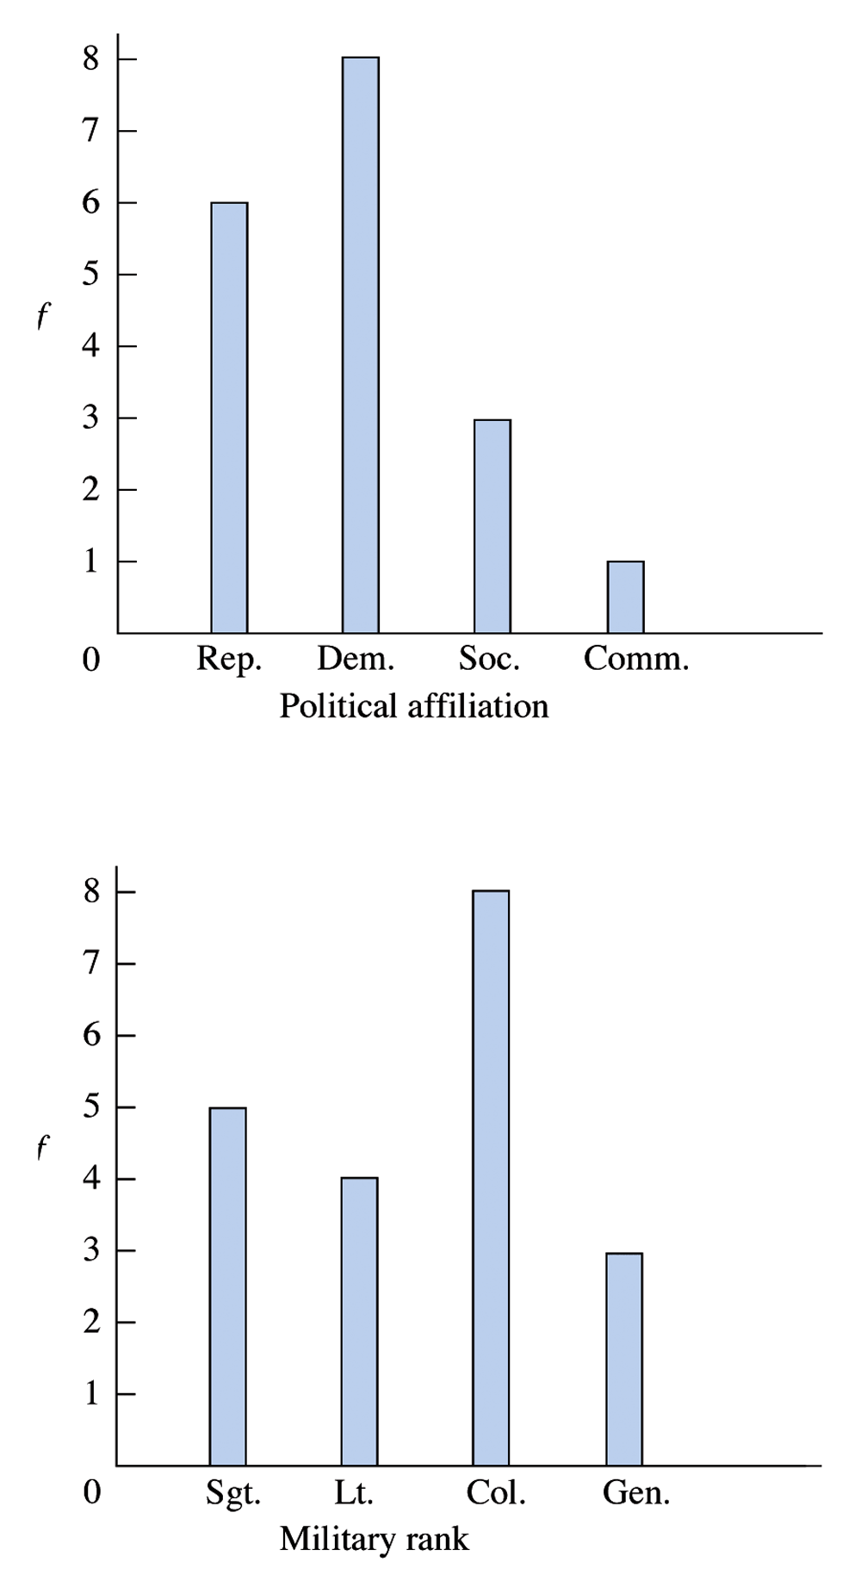
Bar Graphs
Spaces between bars
Distinct categories
Used with nominal scales or qualitative data
Sometimes also used with ordinal scales
Notes:
Bar graph
You see that frequency is represented on the y-axis
Scores represented on the x-axis.
A bar is drawn above each x-category – so that height corresponds to frequency (on the y-axis)
What is the scale of measurement for the first graph? (nominal)
What about the second graph? (ordinal)
Bar graphs are used with nominal (distinct categories) and ordinal scales of measurement (where you can’t assume that the categories are the same size).
Also notice that there are spaces between the categories.

Slide 23
Histograms
No spaces between bars
Labels directly under each box
Used with ordinal, interval, or ratio scales
Usually used with discrete data
Notes:
Histograms are for ratio & interval measurements
Notice here the bars touch
Histograms – usually used for small ranges

Slide 24
Polygons
Used when
larger range of scores
Interval or ratio scales
Continuous data
Dot centered above each score if it is discrete data
Notes:
Polygons are also used for interval and ratio data.
Again frequency represented on y-axis and scores represented on x-axis
A dot is placed over the midpoint of the category
Dots are connected using a straight line
Connect the graph to the x-axis (one pt above & below the high & low frequency)
Polygons are more often used with large ranges.
Source: Gravetter and Wallnau (2008) page 47.

Slide 25
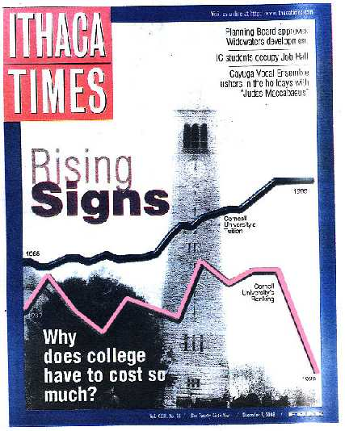
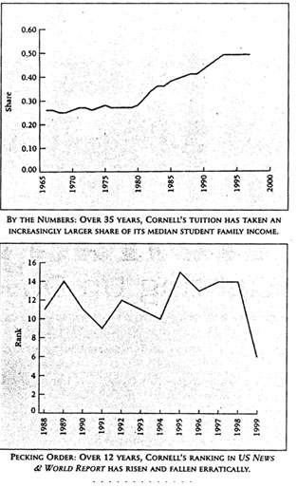
“Most misleading graph ever published”
Notes:
What's wrong with these pictures? More careful reading of the whole article, buried several pages into the paper, reveals a different story: (1) The ranking graph covers an 11 year period, while the tuition graph covers 35 years; yet they are shown simultaneously with the same apparent width on the same horizontal "scale". The graph treats unequal scales as if they are equal. (2) The vertical scale for tuition and ranking could not possibly have common units, but the ranking graph is placed under the tuition graph creating the impression that cost exceeds quality. University ranking is an ordinal measure & tuition is ratio (a proportion of income). (3) The graph uses misleading starting points. The line representing quality of education (Cornell’s rank compared to other institutions) lower than the line representing tuition costs as a proportion of income, suggesting that an institution already failing to deliver what students are paying for has, over the last 11 or 35 years (not sure which) became dramatically worse. The scales should not be placed in the same graph. (4) And here is the masterstroke: the sharp "drop" in the ranking graph over the past few years actually represents the fact that Cornell's rank has IMPROVED from 15th TO 6^{th .} The graph actually reverses the implied meaning of up and down.
Other more recent examples of graphs that can be misleading can be found here. http://www.statisticshowto.com/misleading-graphs/

Slide 26
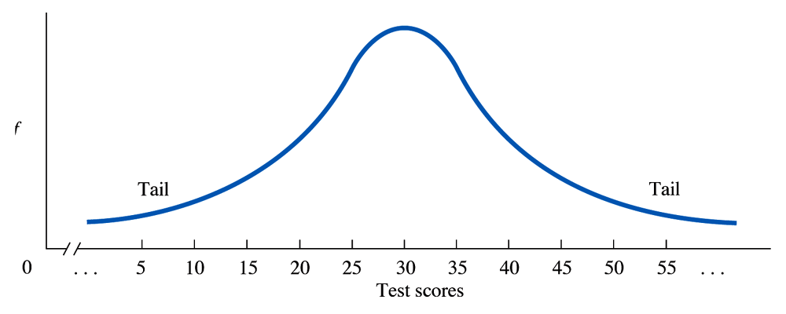
Distributions
Normal curve
Notes:
Normal curve (commonly occurring in population)
The normal curve is not a single curve, rather it is an infinite number of possible curves, all described by the same algebraic expression: (we’re not going to worry about the equation)
Symmetrical, bell-shaped distribution
Values in the middle of the curve have a greater probability of occurring than values in the tails.
Tails don’t touch X axis
Many types of data that are of interest to psychologists are normally distributed (e.g., intelligence, SAT scores)
Drawn as a smooth curve (compared to jagged curves in polygons to signify you are not connecting precise frequencies but are showing relative changes)

Slide 27
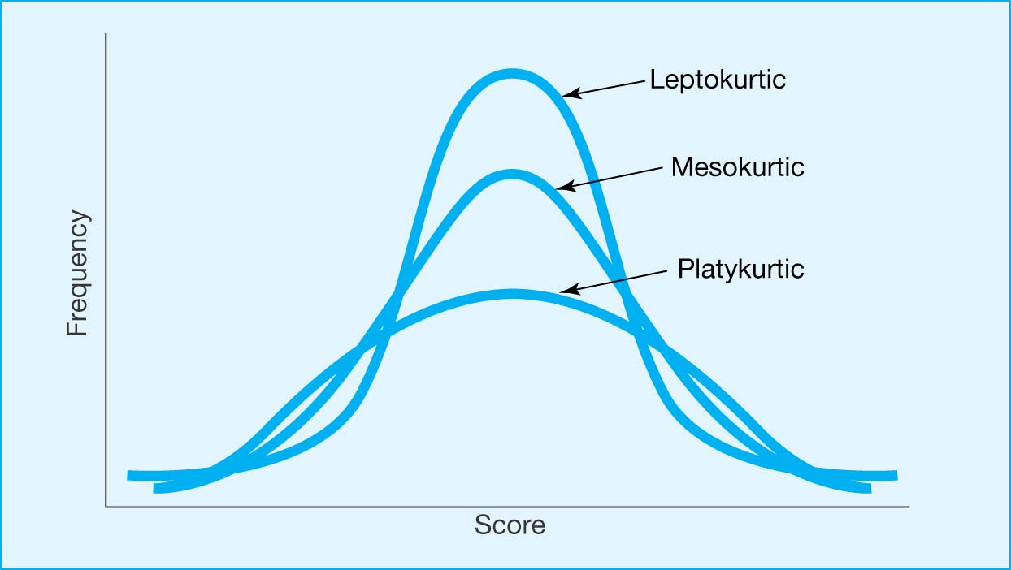
Variations in Distributions
Kurtosis = how peaked or flat distribution
Mesokurtic = normal
Leptokurtic = thin
Platykurtic = broad/ fat
Notes:
Kurtosis – how peaked or flat (skinny or fat) a distribution is
Mesokurtic = normal distribution
Leptokurtic = thin
Platykurtic = broad or fat

Slide 28
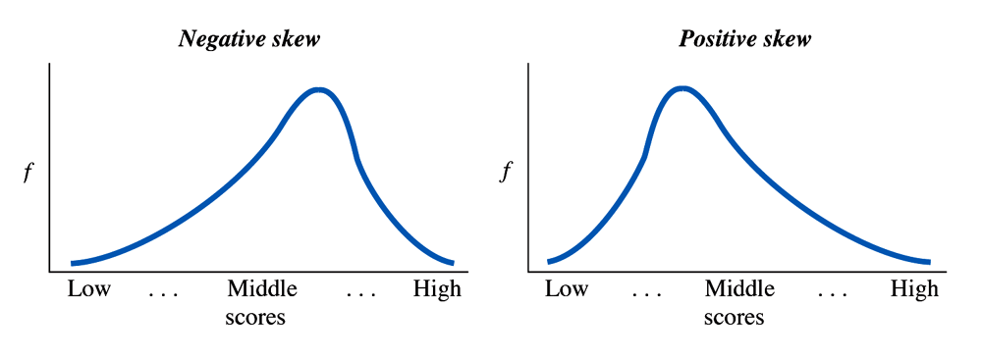
Variations in Distributions
Negatively skewed
(left skew)
Notes:
Not all distributions are symmetrical. A skewed distribution is not symmetrical as it has only one pronounced tail
A distribution may be either negatively skewed or positively skewed
Whether a skewed distribution is negative or positive corresponds to whether the distinct tail slopes toward or away from zero
A negatively skewed distribution contains extreme low scores that have a low frequency and most people have high scores.
The tail is on the left side of the graph
Tail slopes toward zero
Examples:
Grade inflation
Class survey data: Extent to which you enjoy psychology classes

Slide 29
Variations in Distributions
Positively skewed
(right skew)
Notes:
Positively skewed distribution
The tail is on the right side of the graph (slopes away from zero)
Most people have low scores; few people have high scores

Slide 30
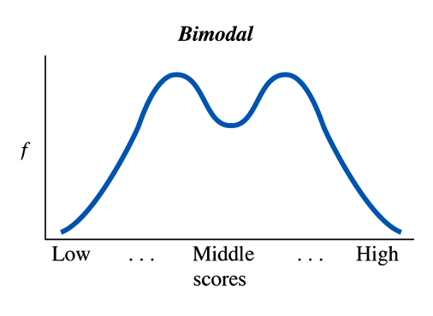
Variations in Distributions
Bimodal
Notes:
A bimodal distribution is a symmetrical distribution containing two distinct humps

Slide 31
Practice 3
Using the following data set:
Create a simple distribution table, find the relative frequency, find the cumulative frequency, and find the cumulative percent for each remaining data point --- also, create a graph.
Note: Round to the 2nd decimal place (assume interval scale)
14 | 14 | 13 | 15 | 11 | 15
13 | 10 | 12 | 13 | 14 | 13
14 | 15 | 17 | 14 | 14 | 15

Slide 32
Practice 3: Histogram
Frequency
10
11
12
13
14
15
17
Scores

Slide 33
Practice 3: Answers
X | f | rf | cf | c%
17 | 1 | .06 | 18 | 100%
16 | 0 | .00 | 17 | 94%
15 | 4 | .22 | 17 | 94%
14 | 6 | .33 | 13 | 72%
13 | 4 | .22 | 7 | 39%
12 | 1 | .06 | 3 | 17%
11 | 1 | .06 | 2 | 11%
10 | 1 | .06 | 1 | 06%
Notes:
Percentile=cf/N
N=18
Rel. f.=1

